Slide 1
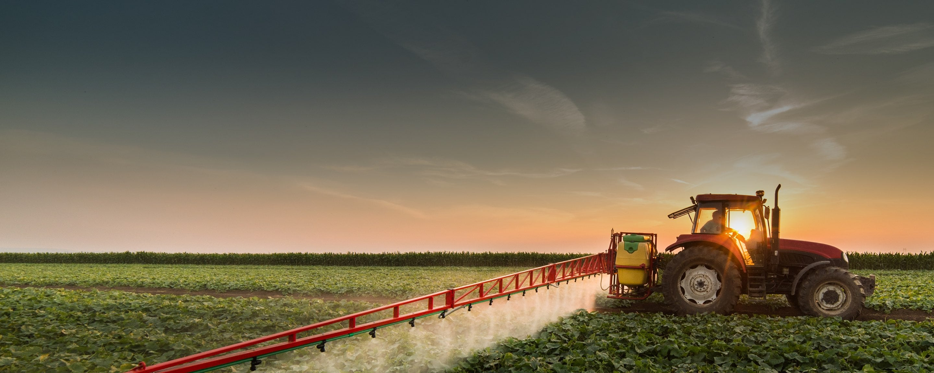











ANIMAL DETECTION
AND
CROP PROTECTION

Slide 2
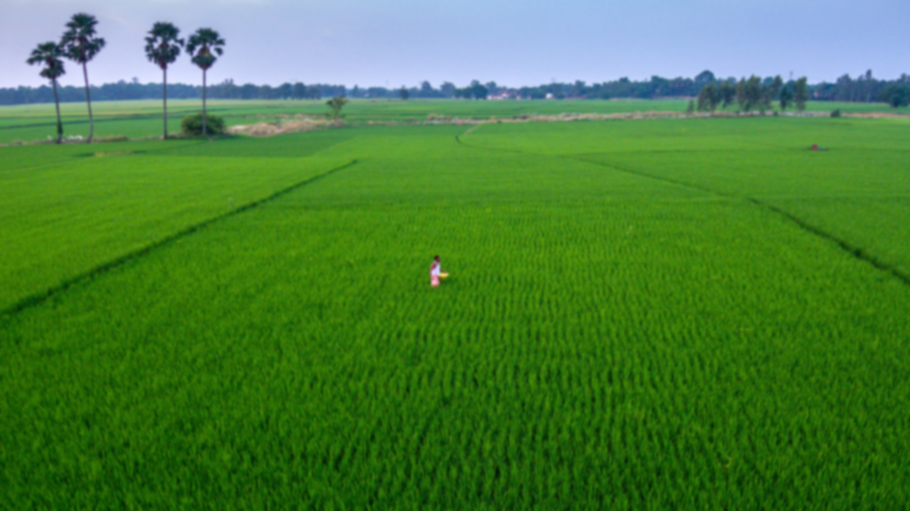

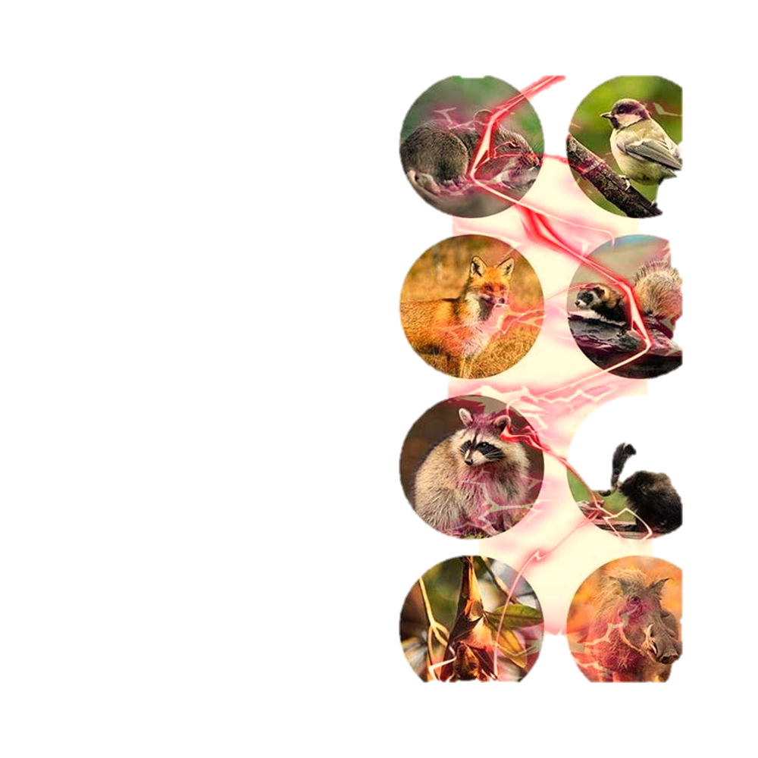



ABSTRACT
One use of machine learning for crop security is to develop a system that can detect animals in the field and then using automated deterrents to keep them away from the crops.A Convolutional Neural Network has been used on Snapshot Serengeti dataset to determine whether the images taken contain an animal or not. Based on this the images can be classified as animal and not animal. The system is able to correctly predict where the animal is in the foreground and then activate deterrents using sensors that can be employed to scare the animals away.

Slide 3

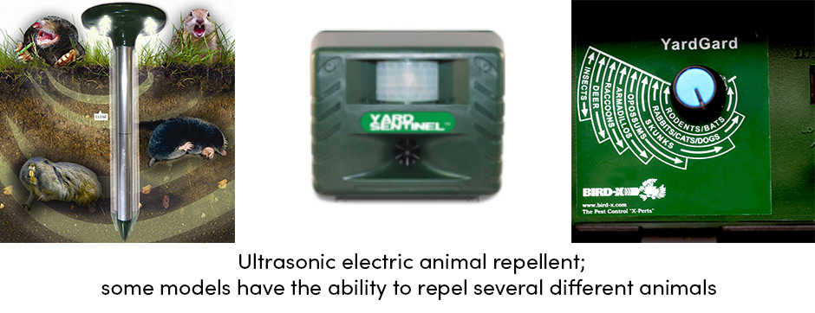
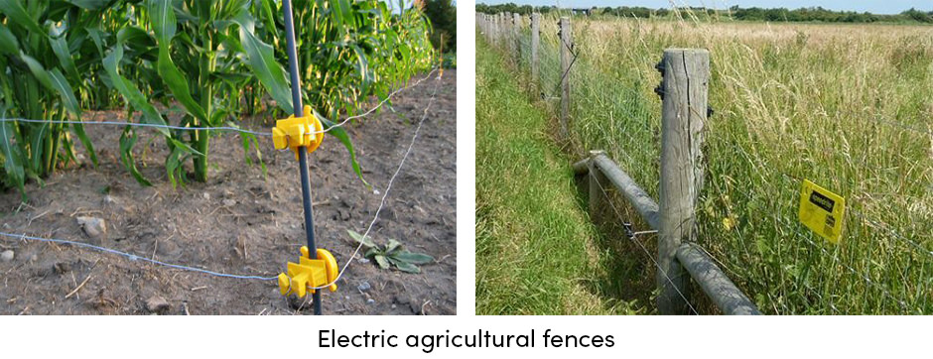

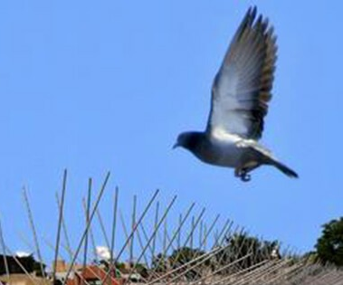
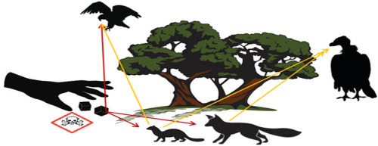
PROBLEM
LETHAL SYSTEMS
ELECTRONIC AGRICULTURAL FENCES
ULTRASONIC REPELLANTS
BIRD SPIKES
POISON BAITS

Slide 4
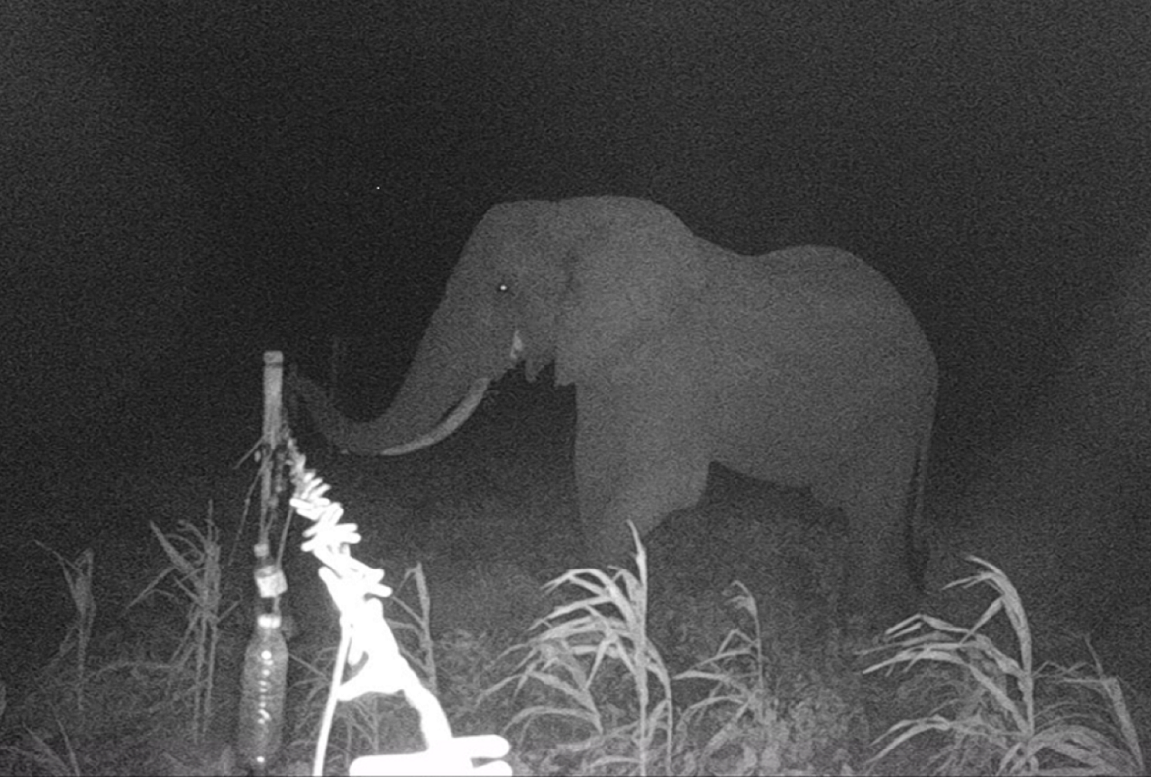
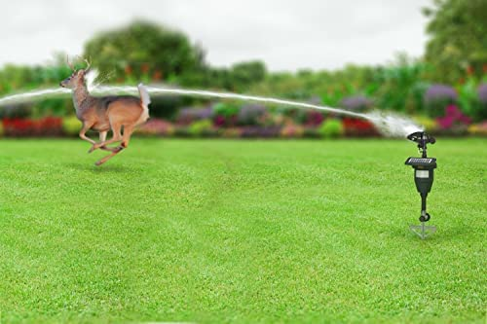
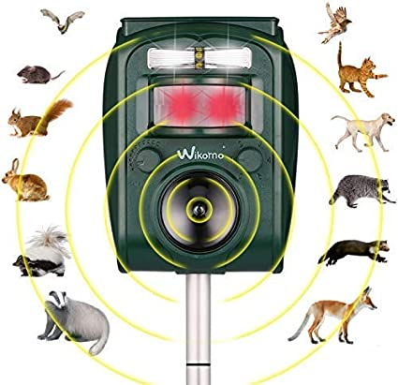
BUSINESS MODEL
SOLUTION
A convolutional neural network has been used on the dataset. The photographs can be classified as either animal or not animal based on this. The system can accurately determine where the animal is in the background with an accuracy of about 85%. Photos of the animals from the dataset as well as other species were used to train the system. However, it could only predict the species of an image, not the image's background. Additionally, we can identify the type of animal causing crop damage, activate a deterrent for that species, and notify farmers when there is a chance that animals will harm their crops. To prevent animals from entering the field, we have created a deterrent that activates upon animal entrance.

Slide 5
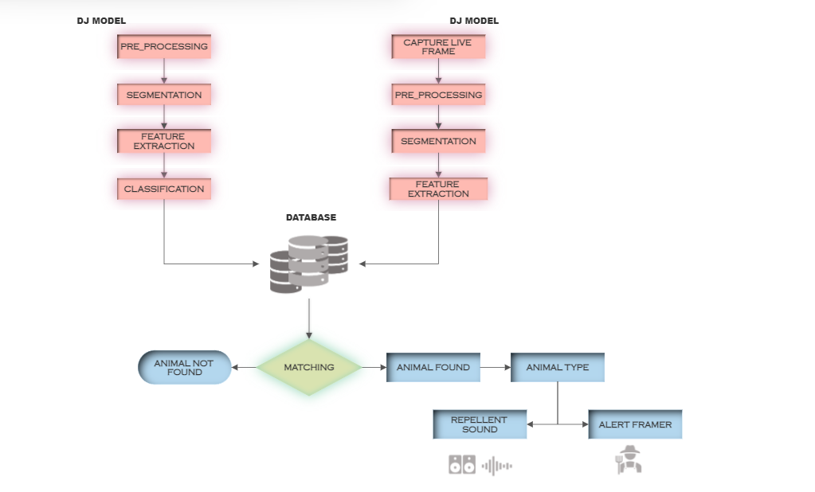
METHODOLOSY PROPOSED
BUSINESS MODEL

Slide 6
THE TEAM
THANK YOU

